Slide 1
Target Corporation
By: Henry Gillis, Nicholas Ricci, Simon Pringle, and Pressley Hendrix

Slide 2
Executive Summary
Target employs a meticulous approach to capital project decisions led by the Capital Expenditure Committee (CEC).
Factors include strategic alignment, brand awareness, competitive dynamics, and customer preferences.
The CEC scrutinizes 10 projects, anticipating fiscal year-end decisions on projects worth nearly $300 million.
Target aims for annual opening of approximately 100 new stores.
Rigorous scrutiny involves understanding market dynamics and customer demographics.
Differentiates from competitors like Wal-Mart and Costco by offering a holistic shopping experience.
Commitment to brand awareness evident through substantial advertising expenditures.

Slide 3
Executive Summary (Continued)
CEC conducts a rigorous evaluation considering financial analyses, sensitivity assessments, and long-term implications.
Factors such as tax incentives, demographics, and potential competition integral to decision-making.
CFO Doug Scovanner prioritizes five projects, considering NPVs, short-term gains, and long-term growth.
Target emerges as a company committed to strategic, customer-centric, and financially sound decision-making, positioned for continued success and growth in the dynamic retail industry.

Slide 4
Target Timeline
1962: The Dayton Company opens the first Target store in Roseville, Minnesota, adopting the Target name to distinguish it as a new discount retailer.
1995: The first SuperTarget store opens in Omaha, Nebraska, and Target.com is launched in 1999.
2000: Dayton Hudson officially changes its name to Target Corporation.
2005: Target Corporation becomes a major retailing powerhouse with $52.6 billion in revenues from 1,397 stores in 47 states.
February 2000: Doug Scovanner becomes the CFO of Target Corporation.
November 14, 2006: Doug Scovanner prepares for the November meeting of the Capital Expenditure Committee (CEC), reviewing 10 projects representing nearly $300 million in capital-expenditure requests.
January 2007: Approaching the fiscal year-end, Target needs to determine capital expenditure plans for future store growth and development.
November 2007: Gopher Place, a new P04 store, is scheduled to open in October 2007.
March 2007: The Barn, a new P04 store in a small rural area, is scheduled to open.
October 2007: Goldie's Square, a SuperTarget store, is scheduled to open.
March 2007: Stadium Remodel, a remodel of an existing SuperTarget store, is scheduled to open.

Slide 5

Doug Scovanner
Known For:
Financial Leadership: As Target Corporation's CFO, Doug Scovanner led financial planning and decision-making.
Strategic Decision-making: His role in the CEC showcased a meticulous approach aligning financial decisions with Target's growth.
Commitment to Shareholder Value: Prioritized decisions contributing to sustained growth and maximizing shareholder value.
Notable Management Decisions:
Project Prioritization: Crucially selected and prioritized capital projects aligned with Target's growth and financial goals.
Balancing Short-term and Long-term Goals:** Balanced short-term gains with long-term growth, considering the competitive retail landscape.
Financial Rigor: Emphasized rigorous evaluation processes, ensuring financial soundness through detailed analyses and sensitivity assessments.
Response to Market Dynamics: Addressed market dynamics, including competition and changes in consumer preferences, strategically positioning against industry giants.

Slide 6
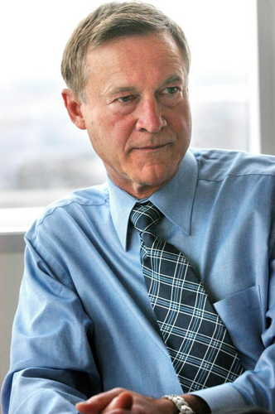
Bob Ulrich
Known For:
Strategic Visionary: Bob Ulrich was recognized for his strategic vision as the Chairman and CEO of Target Corporation.
Leadership During Growth: Led Target Stores as CEO in 1987, contributing significantly to the company's growth.
Operational Efficiency: Emphasized operational efficiency and effectiveness in managing Target's expansion.
Notable Management Decisions:
Brand Differentiation: Focused on brand differentiation, positioning Target as a unique and stylish shopping experience.
Expansion Strategies: Oversaw the expansion of Target, opening new stores and adapting to changing retail landscapes.
Customer-Centric Approach: Emphasized a customer-centric approach, understanding and catering to evolving consumer preferences.
Diversification: Explored diversification strategies, including the launch of SuperTarget stores and the Target.com website.

Slide 7
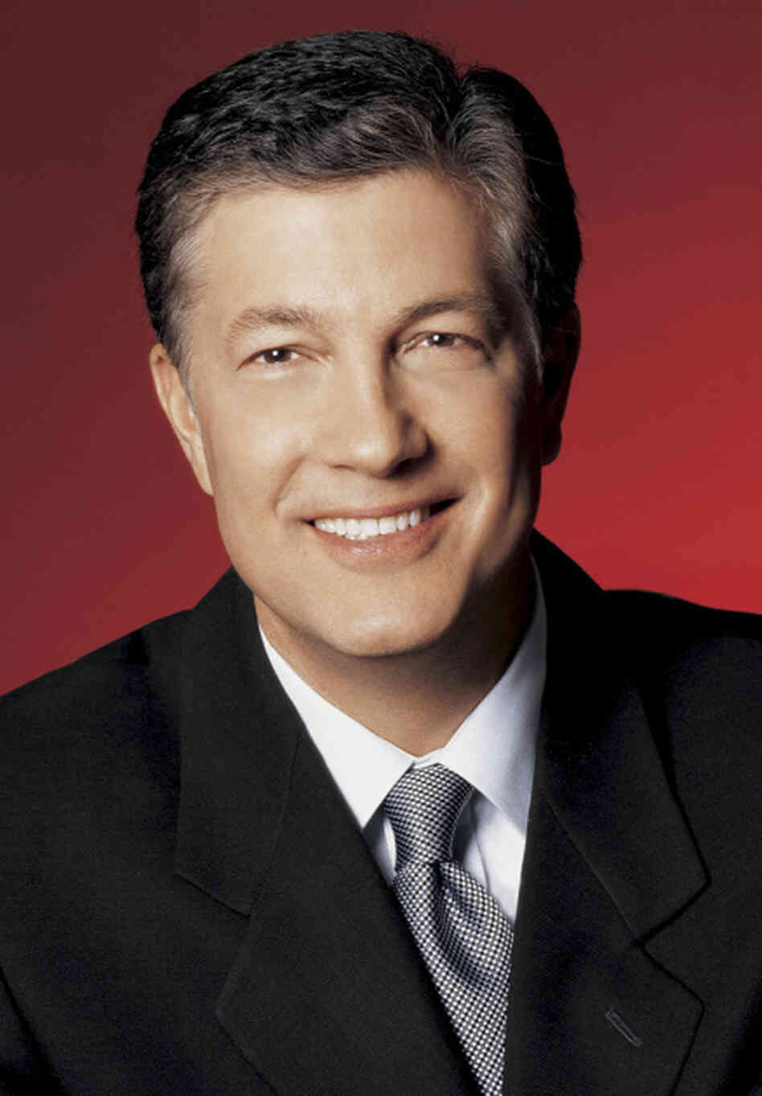
Gregg Steinhafel
Known For:
Long-Term Dedication: Gregg Steinhafel was known for his long-term dedication to Target Corporation, starting as a merchandising trainee in 1979.
Rise Through Ranks: Demonstrated leadership by rising through the ranks, eventually becoming the President of Target Stores.
Brand Advocacy: Actively advocated for and contributed to the Target brand's success.
Notable Management Decisions:
Merchandising Expertise: Applied merchandising expertise to enhance the product offerings and shopping experience at Target.
Presidential Leadership: Led Target Stores as President, shaping the company's direction during his tenure.
Strategic Initiatives: Played a key role in implementing strategic initiatives, aligning with Target's commitment to a unique and affordable retail experience.

Slide 8

Troy Risch
Known For:
Rapid Career Advancement: Troy Risch was recognized for his rapid career advancement, being promoted to Executive Vice President in September 2006.
Leadership in Stores: Demonstrated leadership within Target Corporation, particularly in the stores division.
Strategic Contributions: Made strategic contributions to the company's growth and operations.
Notable Management Decisions:
EVP Role: Successfully assumed the role of Executive Vice President, showcasing his capabilities in a high-ranking leadership position.
Operational Excellence: Contributed to operational excellence within Target's stores, focusing on enhancing the customer experience.
Strategic Decision-Making: Participated in strategic decision-making processes, aligning with Target's goals and objectives.

Slide 9

John Griffith
Known For:
Leadership in Property Development: John Griffith was known for his leadership in the area of Property Development, rising to the position of Executive Vice President.
Long-Term Commitment: Demonstrated a long-term commitment to Target, having been promoted to EVP in February 2005 from the position of Senior Vice President of Property Development.
Strategic Vision: Provided strategic vision and direction in the development and management of Target's properties.
Notable Management Decisions:
Promotion to EVP: Successfully transitioned from Senior Vice President to Executive Vice President, showcasing his leadership abilities and contributions.
Strategic Property Investments: Contributed to the strategic selection and development of properties, aligning with Target's overall growth strategy.
Operational Excellence: Focused on operational excellence within the Property Development division, ensuring the efficient execution of projects.

Slide 10
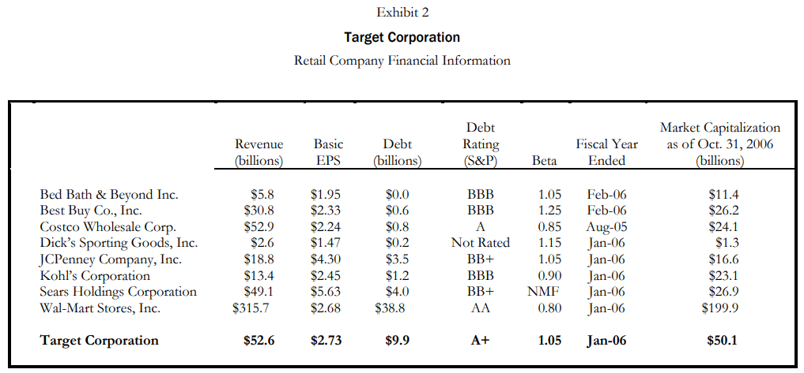
Exhibit 2
Market Dominance:
Wal-Mart and Target lead in market capitalization and revenue.
Signifies their strong positions in the retail industry.
Profitability:
Costco and Wal-Mart show moderate to higher EPS, reflecting strong profitability.
Target's EPS of $2.73 indicates solid financial performance.
Debt Levels:
Target maintains relatively lower debt compared to Walmart, ensuring a more balanced capital structure.
Bed Bath & Beyond exhibit’s the lowest debt level.
Credit Ratings:
Wal-Mart holds a high credit rating (AA), signifying very low credit risk.
Target and Costco maintain strong credit ratings.
Market Sensitivity (Beta):
Wal-Mart has a relatively lower beta indicating lower volatility.
Best Buy and Bed Bath & Beyond show higher market sensitivity.
Analysis Period:
Metrics are as of Jan or Feb 2006, ensuring a consistent basis for comparison.

Slide 11
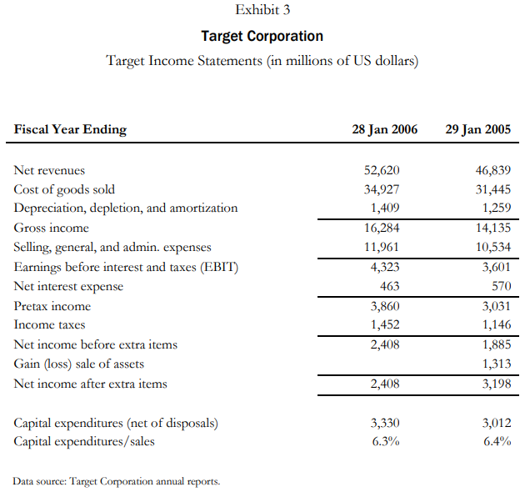
Exhibit 3
Revenue Growth: Target Corporation experienced growth in net revenues from $46.8 billion in the fiscal year ending January 29, 2005, to $52.6 billion in the fiscal year ending January 28, 2006.
Profitability: Gross income in 2006 was $16.3 billion, indicating profitability after deducting the cost of goods sold ($34.9 billion).
Operating Expenses: Selling, general, and administrative expenses amounted to $12 billion in 2006, contributing to the overall cost structure.
Earnings and Taxes: Earnings before interest and taxes (EBTI) were $4.3 billion in 2006, with a net interest expense of $463 million. The company reported a pre-tax income of $3.9 billion and income taxes of $1.5 billion.
Capital Expenditures: The company invested $3.3 billion in capital expenditures in 2006, representing 6.3% of sales, reflecting a commitment to business expansion and improvement.
Net Income: Target Corporation reported a net income of $2.4 billion before considering extra items, showcasing financial stability and positive performance during this period.

Slide 12
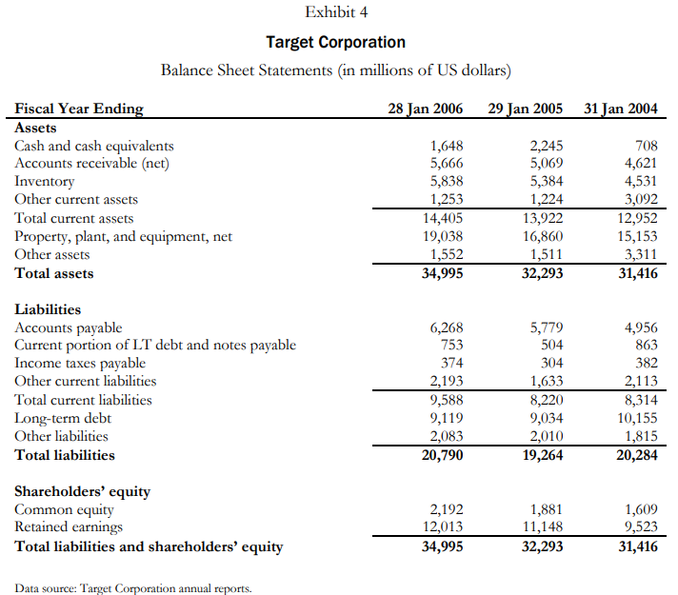
Exhibit 4
Assets:
Steady Growth: Total assets increased from $31.4 billion (2004) to $35 billion (2006).
Balanced Composition: Assets reflect a mix of current and long-term assets.
Liabilities:
Manageable Current Liabilities: Current liabilities remained stable.
Long-Term Debt Stability: Slight increase in long-term debt, but at a reasonable level.
Shareholders' Equity:
Equity Growth: Shareholders' equity increased positively.
Trend Indicators:
Consistent Capital Expenditure: Capital expenditures remained stable as a percentage of sales.

Slide 13
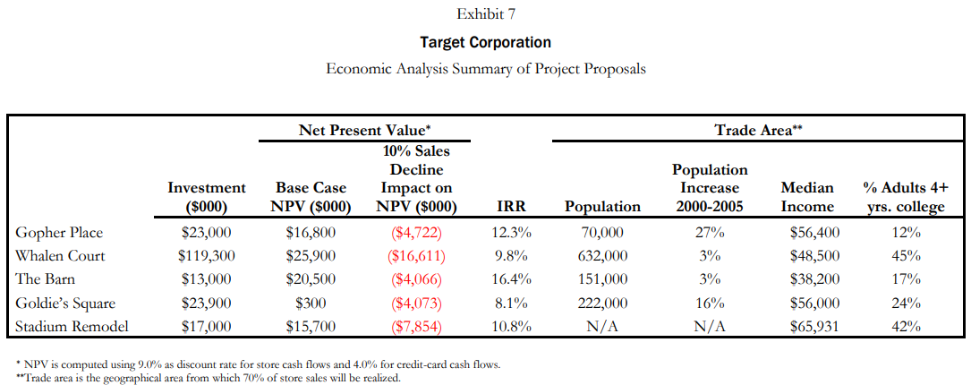
Exhibit 7
The Barn Compared to Other Projects:
Pros:
Highest IRR: Strong potential for profitability.
New Market Opportunity: No nearby stores, minimizing competition.
Favorable NPV: Indicates positive financial returns.
Cons:
Development History: Past failed efforts raise concerns.
Limited Population Growth: Challenges with minimal growth.
Competition: Faces competition from key markets.
Investment:
Lowest investment of $13,000.
10% Sales Decline Impact:
Will lose $4,066 from NPV
% of Adults 4+ Years in College:
17%, positioning moderately in education level.

Slide 14
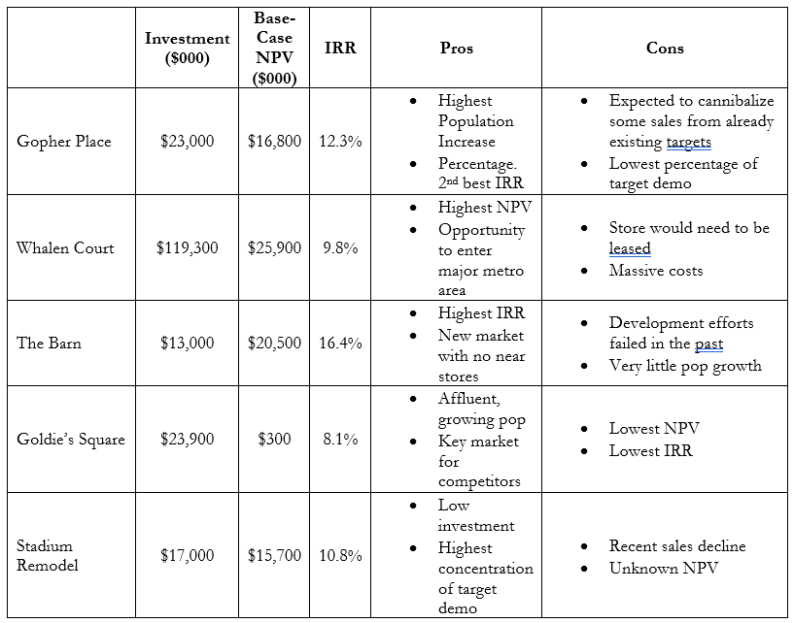
Exhibit 7 Qualitative Analysis

Slide 15
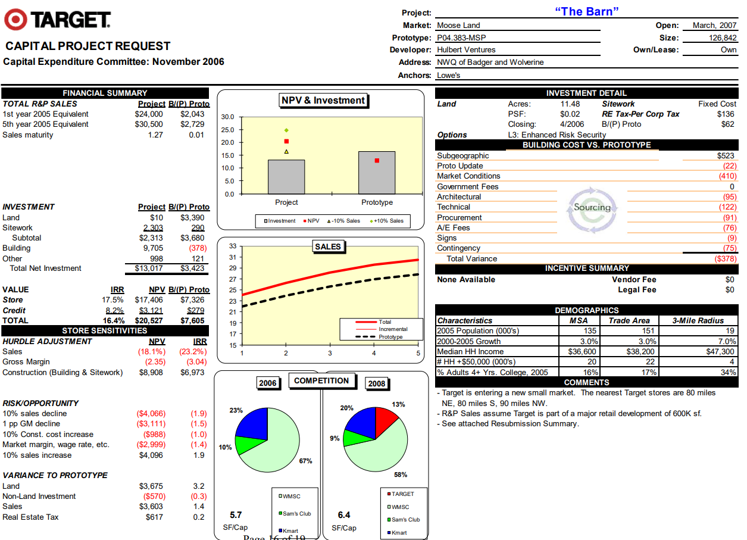
Exhibit 8

Slide 16
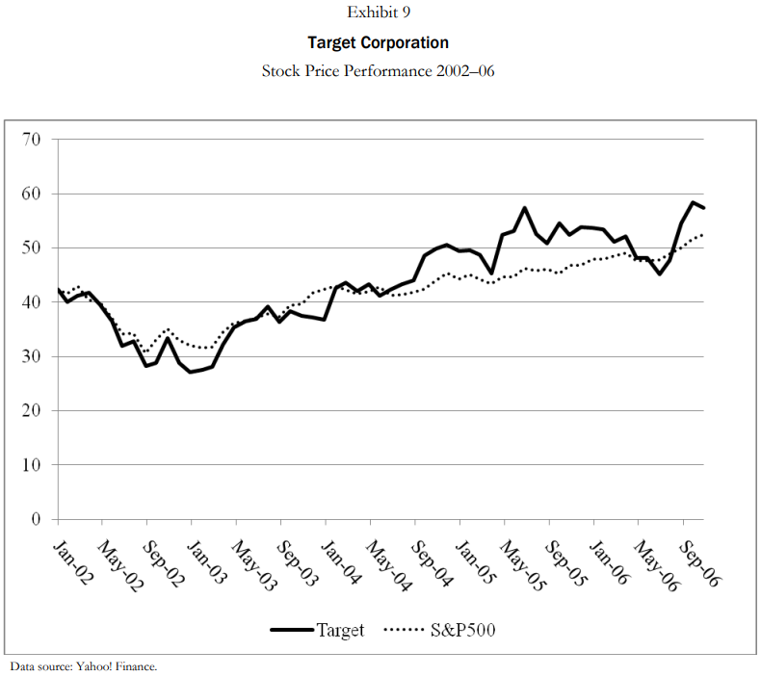
Exhibit 9
Based on the graph there appears to be a general upward trend with Target’s stock price performance.
The S&P500 indicator also agrees that target’s stock prices have been performing better as time has gone by.
Target must continue to make good decisions by choosing the right projects. Projects that generally carry a larger NPV than others are worth pursuing.

Slide 17
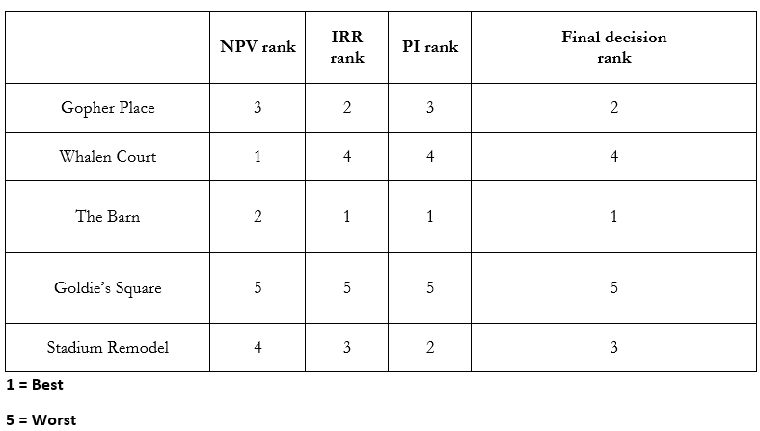
The Final Decision

Slide 18
Why the Barn is the Best Choice
Financial Excellence:
Second-highest NPV reflects robust financial performance.
Highest Profitability Index (2.57) and lowest initial investment cost demonstrate efficient resource utilization.
Profitability and Resilience:
Estimated IRR surpasses competitors, highlighting superior profitability.
Resilience to sales decline with minimal sensitivity (20% decrease in NPV).
Strategic Advantage:
Limited local competitors position The Barn strategically.
Resubmission underscores its importance and commitment, emphasizing its attractiveness.
Alignment with Target's Strategy:
Well-rounded performance aligns with Target's strategic goals.
Outperforms competitors, making The Barn the optimal investment choice.

